Slide 1

ASKING QUESTION
The purpose of computing is insight, not numbers.
– Richard W. Hamming

Slide 2
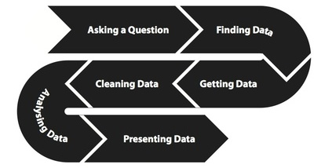

Slide 3

Traditional hypothesis-driven science was based on asking specific questions of the world and then generating the specific data needed to confirm or deny it.
Today data-driven science focuses on generating data on a previously unheard of scale or resolution, in the belief that new discoveries will come as soon as one is able to look at it.
Both ways of thinking will be important to us:
Given a problem, what available data will help us answer it?
Given a data set, what interesting problems can we apply it to?

Slide 4
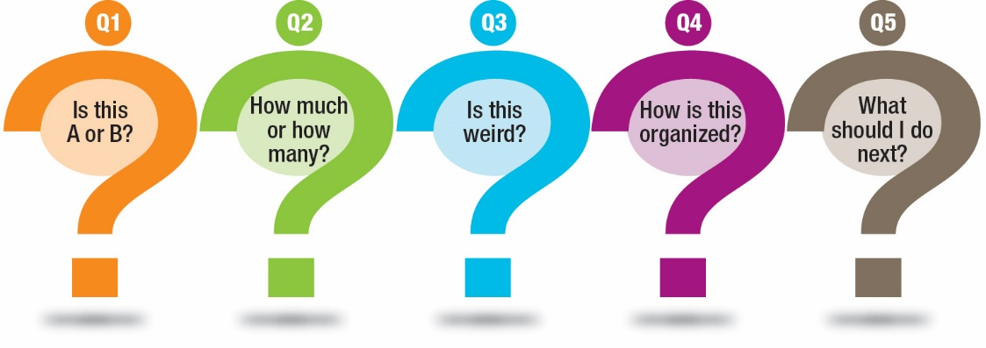
Data scientists always ask questions
Becoming a data scientist requires learning to ask questions about data.
Data scientist job is going to be to turn numbers into insight.
Data scientist ask questions like:
What things might you be able to learn from a given data set?
What do you/your people really want to know about the world?
What will it mean to you once you find out?

Slide 5
The Data Analytic Question
Data can be used to answer many questions, but not all of them.
Before performing a data analysis the key is to define the type of question being asked. Some questions are easier to answer with data and some are harder.
There is a broad categorization of the types of data analysis questions, ranked by how easy it is to answer the question with data.
Source: The Elements of Data Analytic Style http://worldpece.org/sites/default/files/datastyle.pdf

Slide 6
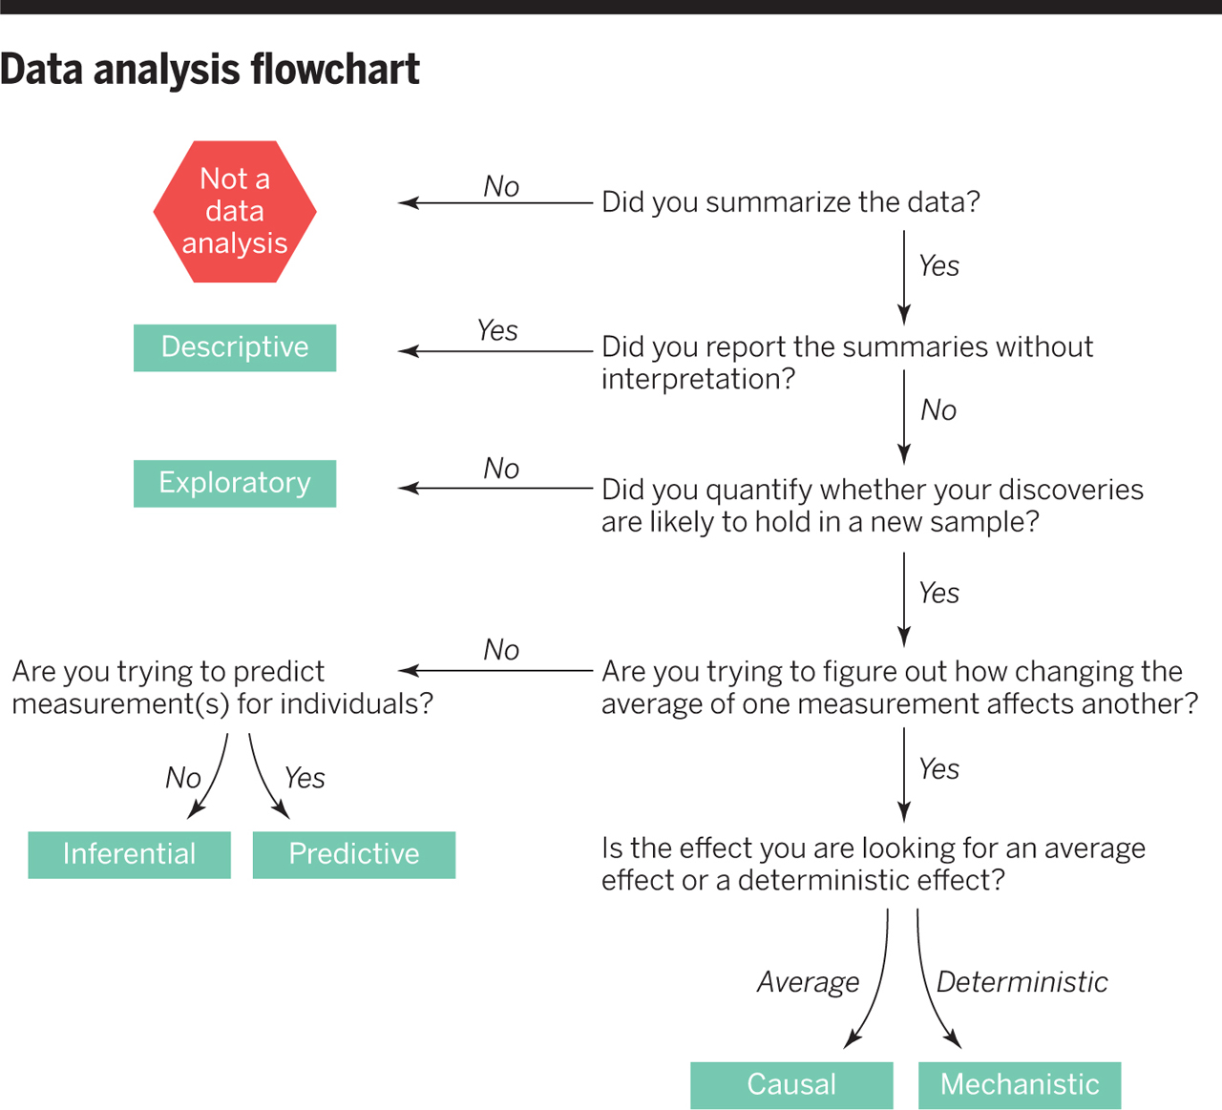

Slide 7
Descriptive
A descriptive data analysis seeks to summarize the measurements in a single data set without further interpretation.
An example is the United States Census. The Census collects data on the residence type, location, age, sex, and race of all people in the United States at a fixed time.
The Census is descriptive because the goal is to summarize the measurements in this fixed data set into population counts and describe how many people live in different parts of the United States.

Slide 8
Exploratory
An exploratory data analysis builds on a descriptive analysis by searching for discoveries, trends, correlations, or relationships between the measurements of multiple variables to generate ideas or hypotheses.
An example is the discovery of a four-planet solar system by amateur astronomers using public astronomical data from the Kepler telescope.
The data was made available through the planethunters.org website, that asked amateur astronomers to look for a characteristic pattern of light indicating potential planets.
An exploratory analysis like this one seeks to make discoveries, but rarely can confirm those discoveries.

Slide 9
Inferential
An inferential data analysis goes beyond an exploratory analysis by quantifying whether an observed pattern will likely hold beyond the dataset in hand.
Inferential data analyses are the most common statistical analysis in the formal scientific literature.
An example is a study of whether air pollution correlates with life expectancy at the state level in the United States.
The goal is to identify the strength of the relationship in both the specific data set and to determine whether that relationship will hold in future data.

Slide 10
Predictive
While an inferential data analysis quantifies the relationships among measurements at population-scale, a predictive data analysis uses a subset of measurements (the features) to predict another measurement (the outcome) on a single person or unit.
An example is when organizations like FiveThirtyEight.com use polling data to predict how people will vote on election day.
In some cases, the set of measurements used to predict the outcome will be intuitive. There is an obvious reason why polling data may be useful for predicting voting behavior.
But predictive data analyses only show that you can predict one measurement from another, they don’t necessarily explain why that choice of prediction works.

Slide 11
Causal
A causal data analysis seeks to find out what happens to one measurement if you make another measurement change.
An example is a randomized clinical trial to identify whether fecal transplants reduces infections due to Clostridium dificile. In this study, patients were randomized to receive a fecal transplant plus standard care or simply standard care.
In the resulting data, the researchers identified a relationship between transplants and infection outcomes.
The researchers were able to determine that fecal transplants caused a reduction in infection outcomes.
Unlike a predictive or inferential data analysis, a causal data analysis identifies both the magnitude and direction of relationships between variables.

Slide 12
Mechanistic
Causal data analyses seek to identify average effects between often noisy variables.
For example, decades of data show a clear causal relationship between smoking and cancer. If you smoke, it is a sure thing that your risk of cancer will increase. But it is not a sure thing that you will get cancer.
The causal effect is real, but it is an effect on your average risk. A mechanistic data analysis seeks to demonstrate that changing one measurement always and exclusively leads to a specific, deterministic behavior in another.
The goal is to not only understand that there is an effect, but how that effect operates.
An example of a mechanistic analysis is analyzing data on how wing design changes air flow over a wing, leading to decreased drag. Outside of engineering, mechanistic data analysis is extremely challenging and rarely undertaken.

Slide 13
Common Mistakes
Correlation does not imply causation
Interpreting an inferential analysis as causal.
Most data analyses involve inference or prediction. Unless a randomized study is performed, it is difficult to infer why there is a relationship between two variables.
Some great examples of correlations that can be calculated but are clearly not causally related appear at http://tylervigen.com
Particular caution should be used when applying words such as “cause” and “effect” when performing inferential analysis. Causal language applied to even clearly labeled inferential analyses may lead to misinterpretation-a phenomenon called causation creep.

Slide 14
Common Mistakes
Overfitting
Interpreting an exploratory analysis as predictive
A common mistake is to use a single, unsplit dataset for both model building and testing.
If you apply a prediction model to the same data set used to build the model you can only estimate “resubstitution error” or “training set error”.
These estimates are very optimistic estimates of the error you would get if using the model in practice.
If you try enough models on the same set of data, you eventually can predict perfectly.

Slide 15
Common Mistakes
N of 1 analysis
Descriptive versus inferential analysis
When you have a very small sample size, it is often impossible to explore the data, let alone make inference to a larger population.
An extreme example is when measurements are taken on a single person or sample.
With this kind of data it is possible to describe the person or sample, but generally impossible to infer anything about a population they come from.

Slide 16
Common Mistakes
Data dredging
Interpreting an exploratory analysis as inferential
Similar to the idea of overfitting, if you fit a large number of models to a data set, it is generally possible to identify at least one model that will fit the observed data very well.
This is especially true if you fit very flexible models that might also capture both signal and noise.
Picking any of the single exploratory models and using it to infer something about the whole population will usually lead to mistakes. As Ronald Coase³ said:
“If you torture the data enough, nature will always confess.”
³http://en.m.wikiquote.org/wiki/Ronald_Coase

Slide 17

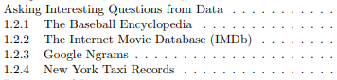
Download with pdfdrive.net

